Slide 1
Improvement Of Policies Using End To End Reinforcement Learning In Deep Q-network
Mitashi Bansal
1CSE 11-Y
A2305219684

Slide 2
Contents
POINTS TO BE DISCUSSED :
What Is Reinforcement Learning {INTRODUCTION}
Need Of Deep Reinforcement Learning {HOW IT DIFFERS FROM MACHINE LEARNING }
Principle On Which It Is Based {FRAMEWORK (M.D.P.)}
ELEMENTS OF REINFORCEMENT LEARNING
COMPONENTS OF AGENT OF REINFORCEMENT LEARNING
Working {EXECUTION OF REINFORCEMENT LEARNING ALGORITHM }
Explanation through “EXAMPLES”
TYPES OF REINFORCEMENT LEARNING
FUTURE SCOPE
CONCLUSION
REFERENCES

Slide 3
Introduction
There are many complex task problems which are out of reach for a simple machine. So, there is a need for a solution for such a problem , so the solution is Reinforcement Learning with deep Q-Network. Due to this advanced deep reinforcement learning, we have many new applications in different fields such as Healthcare, Robotics, smart grids, finance, and much more. Deep reinforcement learning has many algorithms. Deep Q learning is one of them.

Slide 4
How Deep learning differs from Machine learning !!
The default methods that can find pattern in the data and use to analyse and access a specific function is called Machine learning .
It has made great strides when learning from high quality data such as time series, image, and videos leading to the latest development of deep learning .
The machine learning environment responsible for sequential decision making is called Deep Reinforcement learning.
This is an important aspect of empowered learning which means that the agent can change or acquire new behaviour to maximize the reward.

Slide 5
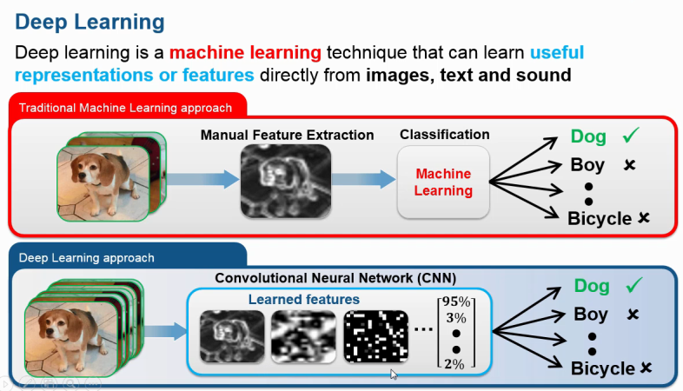
Lets see with an Example !
We have different pictures and we have to classify them so see how the algorithm of both differs !!
Machine Learning Algorithm Rule Wants Associate Structured Knowledge For Classification Of Data Whereas, Deep Reinforcement Learning Able To Classify Pictures Of Each Object From Knowledge Processed Within The Layers Of The Network.
Machine learning is learning from a training set and then applying that learning to a new data set for solution whereas , Deep Reinforcement learning is dynamically learning by adjusting actions based on continuous feedback to maximize a reward.

Slide 6
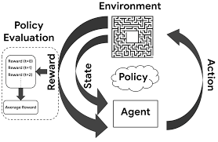
Reinforcement Learning ’s Framework [ M.D.P.]
Here M.D.P. stands for markov decision process .The mathematical framework for outlining an answer within the reinforcement learning state of affairs is termed the Markov Decision method.

Slide 7

Elements Of Reinforcement Learning
Agent and environment
History and state
Atmosphere state
Agent state
Rewards

Slide 8
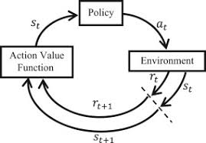
Components Of Reinforcement Learning Agent
Policy
Value function
Environment Model

Slide 9
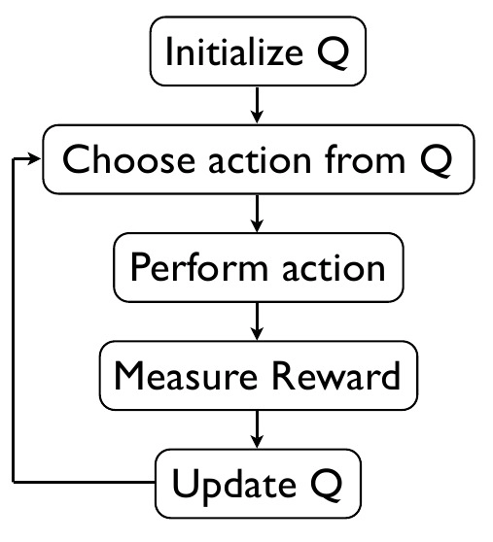
Execution Of Reinforcement learning by Q-Learning

Slide 10
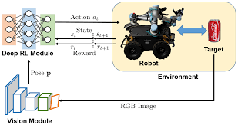
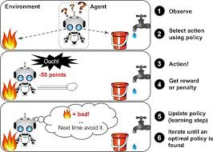
Examples

Slide 11
Types of Reinforcement Learning algorithm
REINFORCEMENT LEARNING
MODEL BASED
MODEL FREE
PURE DESIGNING
EXPERT ITERATION
POLICY OPTIMIZATION
Q-LEARNING

Slide 12
Future Scope
In deep RL, we emphasized at this time the manuscript the central questions are that common sense thought.To the end of the present, new developments within the deep RL field can be assured as firing increases this tendency to take the dominant art of expression to distinguish them so that they will be embedded within a specific type of neural network and they can be trained end-to-end. This can deliver extremely high efficiency and intelligent structures that can be mounted are ready to be displayed An unusual standard, one that would allow America to handle a much better variety of applications than it does these days. Good facilities may work; they are also used for medium learning where considerable development is required in the temporary exclusion domain.

Slide 13
Conclusion
This presentation deals with :
What the reinforcement learning term indicate and explains how machine learning is interrelated with reinforcement learning and how both differ in their working algorithm .
Reinforcement learning is goal-oriented algorithms that learn how to achieve complex goals and pathways, how to increase their points to win the game in multiple moves to increase a certain dimension.
Reinforcement learning actually proposes an appropriate framework for complex tasks and tasks. The best plan is that a man-made agent can learn about interacting with the environment in the same way the agent does.
Then proceeding after, it explains elements of reinforcement learning ,components of its agent, and how it can be implemented with examples. Moving on further it explains that reinforcement learning algorithms can be both model-free ( policy optimisation, Q-learning) and model-based (pure designing,expert iteration ).
At last it tells about what are the futuristic approach and scope of deep reinforcement learning .

Slide 14
REFERENCES
Edited Articles :
[1] Madhu Sanjeevi (2018) ; Ch:13: Deep Reinforcement learning — Deep Q-learning and Policy Gradients ( towards AGI ). September 10 , 2018.
[2] Felix Yu (2018) ; Deep Q Network Vs Policy Gradients .October 12, 2017.
[3] Michal Hrabia (2020) ; Deep Learning Vs. Machine Learning. February 8, 2020 .
Unpublished papers :
[4] Timothy P Lillicrap, Jonathan J Hunt ,Alexander Pritzel, Nicolas Heess ,Tom Erez, Yuval Tassa, David Silver,Daan Wierstra (2015) ; Continuous control with deep reinforcement learning. September 9, 2015 .
Edited Letters :
[5] Volodymyr Mnih , Koray Kavukcuoglu , David Silver , Andrei A. Rusu , Joel Veness , Marc G. Bellemare , Alex Graves , Martin Riedmiller, Andreas K. Fidjeland , Georg Ostrovski , Stig Petersen , Charles Beattie , Amir Sadik , Ioannis Antonoglou , Helen King , Dharshan Kumaran Daan Wierstra , Shane Legg & Demis Hassabis (2015) ; Human-level control through deep reinforcement learning .February 26, 2015.
Electronic books :
[6] Vincent François-Lavet McGill University (vincent.francois-lavet@mcgill.ca) ,Peter Henderson McGill University (peter.henderson@mail.mcgill.ca), Riashat Islam McGill University (riashat.islam@mail.mcgill.ca) ,Marc G. Bellemare Google Brain (bellemare@google.com Joelle Pineau Facebook) , McGill University (jpineau@cs.mcgill.ca) (2018) ; An Introduction to Deep Reinforcement Learning. December 3 , 2018 .
[7] J. Zico Kolter ,Carnegie Mellon University ; Introduction to Reinforcement Learning.
Other Websites :
[8] Spinning Up Openai , Stackexchange , Parsers .

Slide 15


